Slide 1
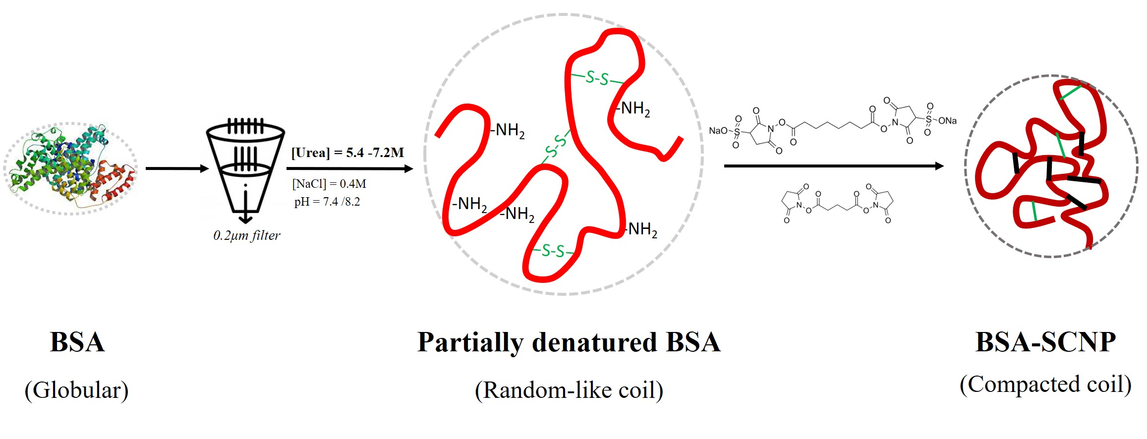
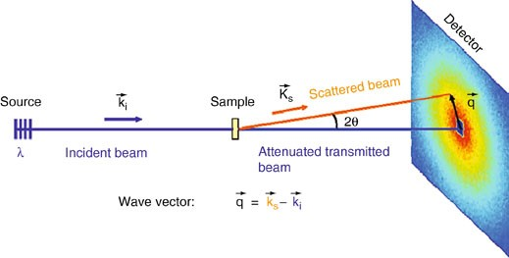
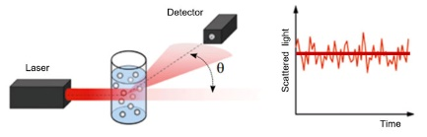
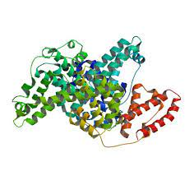




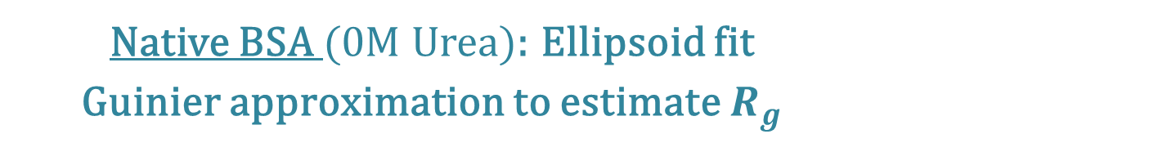

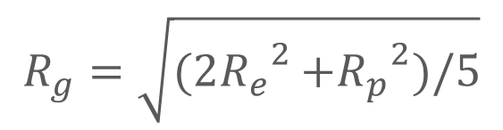
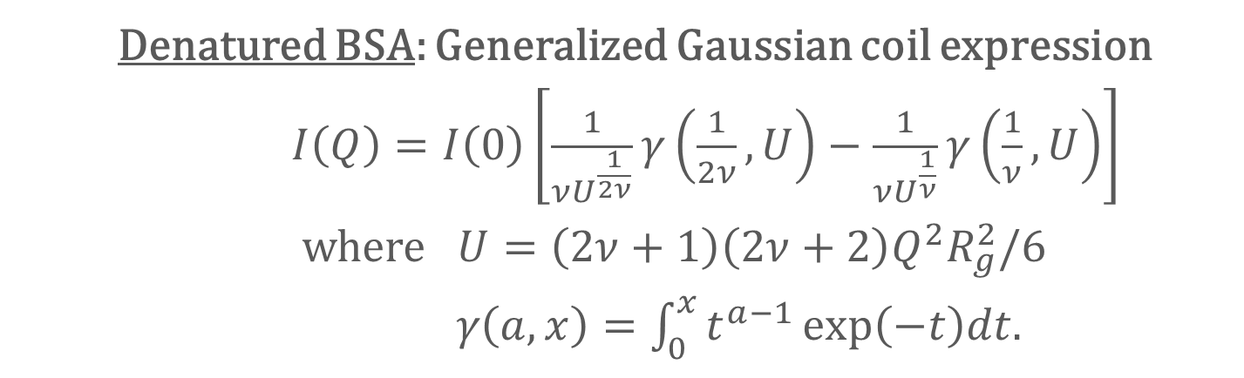
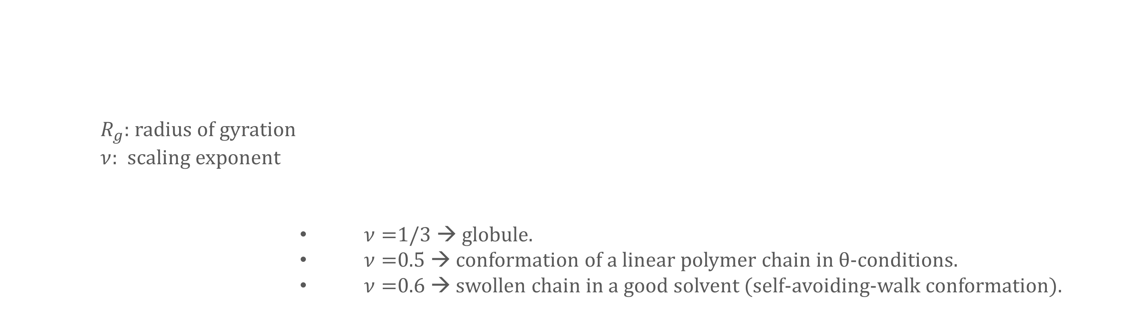

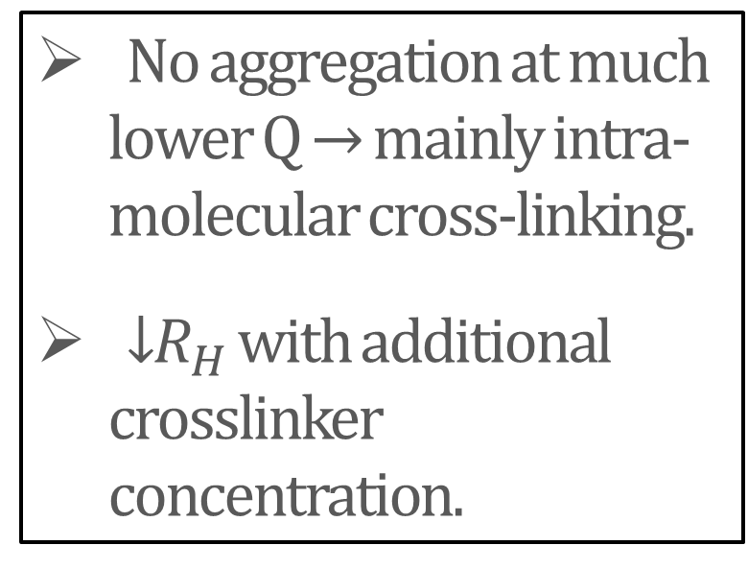

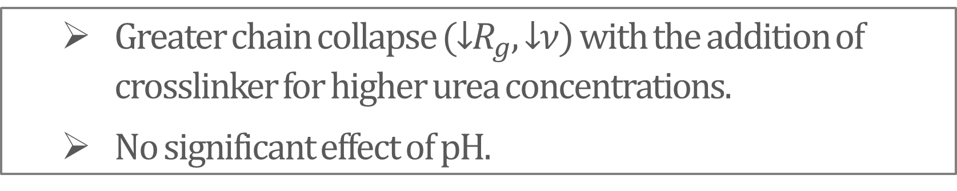



Effect of the polymer conformation on the structure of protein - single chain nanoparticles
INTRODUCTION
Thu Phuong Le¹, Leide Cavalcanti², Juan Colmenero^{1,3}, Josetxo Pomposo^{1,4}, Arantxa Arbe¹ and Paula Malo De Molina^{1,4}
METHODOLOGY
  Single chain nanoparticles (SCNPs) are unimolecular polymer chains folded or collapsed via intra-molecular cross-linking under high dilution, leading to sparse conformations and a topological polydispersity similar
  to that of intrinsically disordered proteins (IDPs).
  To extend SCNPs to polypeptides for biocompatibility purposes, it is important to understand the role of the chain conformation of the
  precursor on the resulting SCNP morphology. For this, we have systematically varied the solvent conditions (pH and denaturant concentrations) of BSA solutions as well as the crosslinker (lengths and concentrations) and studied the resulting SCNPs by scattering techniques.
¹ Materials Physics Center (CSIC–UPV/EHU) San Sebastián, Spain.
² ISIS Neutron and Muon source, Rutherford Appleton Laboratory, England.
³ Donostia International Physics Center, San Sebastián, Spain.
⁴ IKERBASQUE – Basque Foundation for Science, Bilbao, Spain.
BSA CONFORMATION
long crosslinker – BS3
SANS
θ
short crosslinker - DSG
DLS/SLS
Structural control by solvent conditions
Native BSA (0M Urea): Ellipsoid fit
Guinier approximation to estimate $R_{g}$
$$ν$$
pH=8.2
$$≈$$
$$R_{p}$$
$$R_{g}=\sqrt{(2{R_{e}}^{2}⁡+{R_{p}}^{2})/5}$$
pH=8.2
pH=7.4
$R_{g}$: radius of gyration
$ν:$ scaling exponent
  $ν=$1/3 → globule.
  $ν=$0.5 → conformation of a linear polymer chain in θ-conditions.
  $ν=$0.6 → swollen chain in a good solvent (self-avoiding-walk conformation).
$$R_{e}$$
$$I\left(Q\right)=I\left(0\right)exp⁡(−{R_{g}}^{2}Q^{2}/3)$$
pH=7.4
Denatured BSA: Generalized Gaussian coil expression
$I\left(Q\right)=I\left(0\right)\left[\frac{1}{νU^{\frac{1}{2ν}}}γ\left(\frac{1}{2ν},U\right)−\frac{1}{νU^{\frac{1}{ν}}}γ\left(\frac{1}{ν},U\right)\right]$
where $U=\left(2ν+1\right)\left(2ν+2\right)Q^{2}R_{g}^{2}/6$
$γ\left(a,x\right)=\int_{0}^{x}{t^{a−1}\exp\left(−t\right)dt}$.
SCNP FORMATION
pH=8.2
pH=7.4
The higher urea concentration leads to larger precursor chain expansion (↑$R_{g}$, ↑ $ν$).
pH has only a small effect.
1) Influence of the solvent conditions
Fitting parameters to a generalized Gaussian coil
pH 7.4
$$ν$$
%cross-linker
Long crosslinker
[urea] = 5.4M
[urea] = 6.3M
[urea] = 7.2M
pH 8.2
Greater chain collapse (↓$R_{g}$, ↓$ν$) with the addition of crosslinker for higher urea concentrations.
No significant effect of pH.
2) Complementary light scattering measurements
3) Effect of the crosslinker length
SLS
SANS
No aggregation at much lower Q → mainly intra-molecular cross-linking.
↓$R_{H}$ with additional crosslinker concentration.
Short crosslinker
Longer crosslinker is more effective in chain compaction.
% cross-linker
DLS
Long crosslinker
Θ=100˚
CONCLUSION
@7.2M urea
7.2M urea, pH 7.4, long crosslinker
Successful control of the protein collapse by varying solvent conditions and crosslinker lengths:
The higher urea concentration leads to larger precursor chain expansion.
The longer the crosslinker, the easier the loop formation along the chain → better collapse.
→ Our results show that the precursor chain conformation has an impact on the BSA-SCNP microstructure.
Paula Malo de Molina, Thu Phuong Le, Amaia Iturrospe, Urs Gasser, Arantxa Arbe, Juan Colmenero, and José A. Pomposo, ACS Omega 2022 7 (46), 42163-42169

