Slide 1



Tail-unsaturation Enables Fine-tuning on the Rheology of Sugar-based Surfactants
Jia-Fei Poon

Slide 2



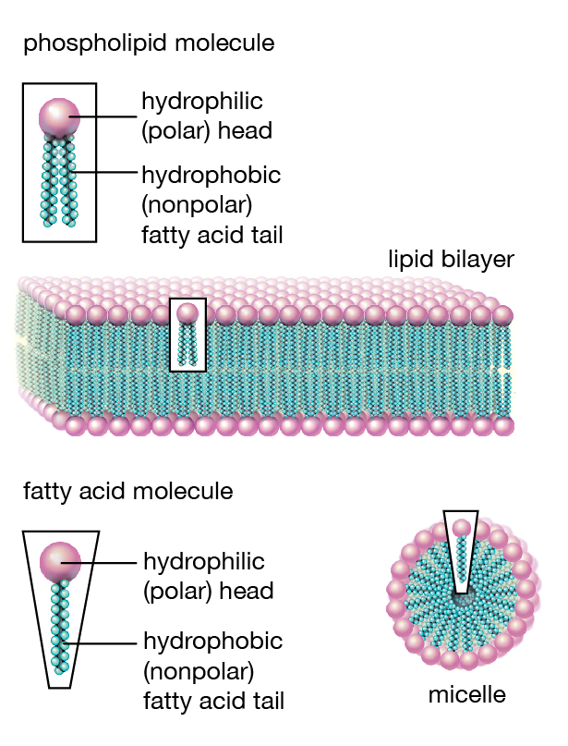
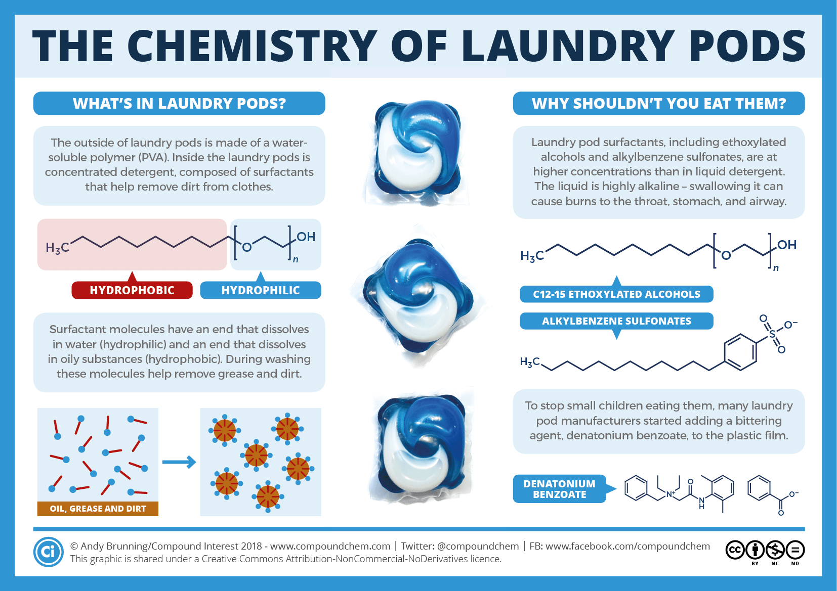

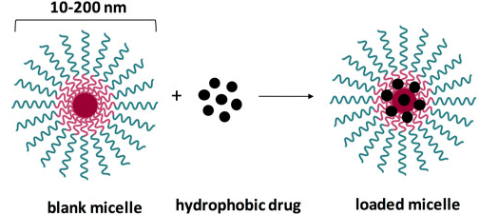
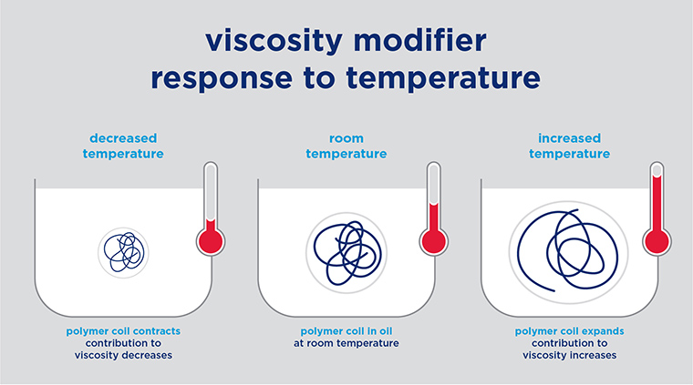

Detergent
Surfactants
Compounds that lowers the surface
tension between two phases
Cosmetic products
Structure
H₂O
Consist of a hydrophilic head group and
hydrophobic tail
Pharmaceutics
Applications
Pharmaceutics, cosmetics,
detergents etc

Slide 3
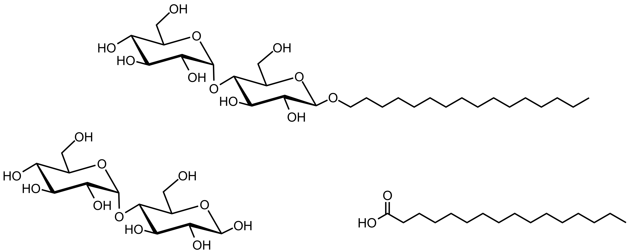

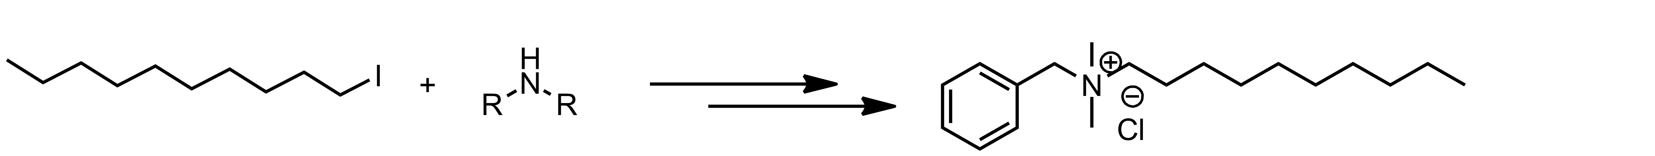
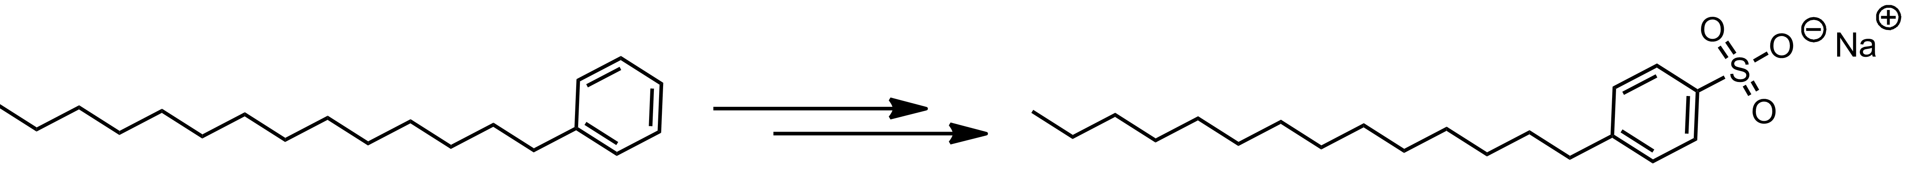
Further Exploration
To link the physical properties with
the chemical architecture
Background and Aims
Surfactants:
Sugar-based Surfactants:
A Greener Option
02
01
Aliphatic
tail
Sugar-based
head group
01
Not dependent on fossil-based
raw materials
Sustainable
Renewable
Renewable
02
Non-toxic
Safe
versus
03
03
Minimized impact on aquatic
Environment
Fossil-
based
Ecosystem
BAC
04
Rheology
Non-Newtonian rheology
LAS

Slide 4
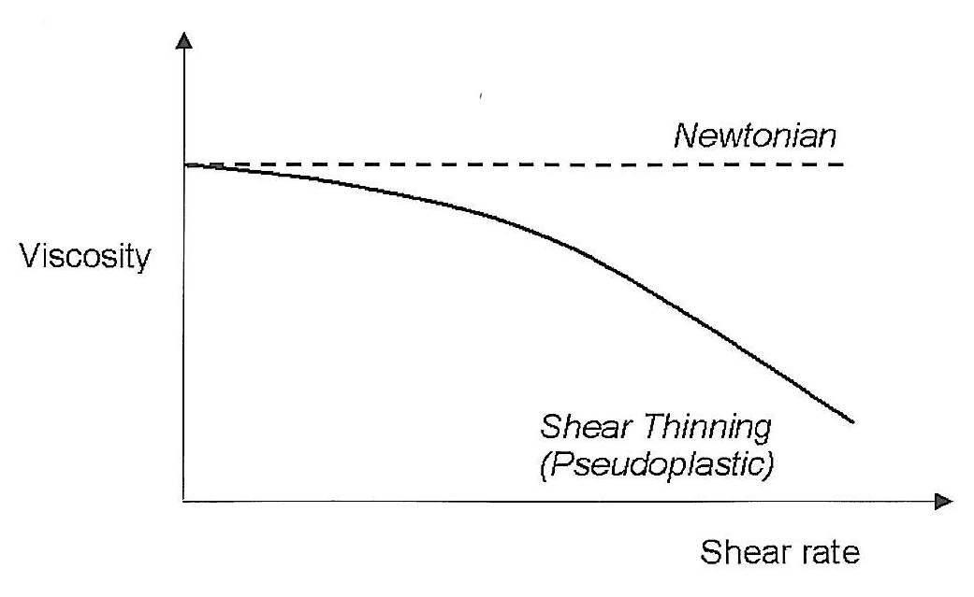
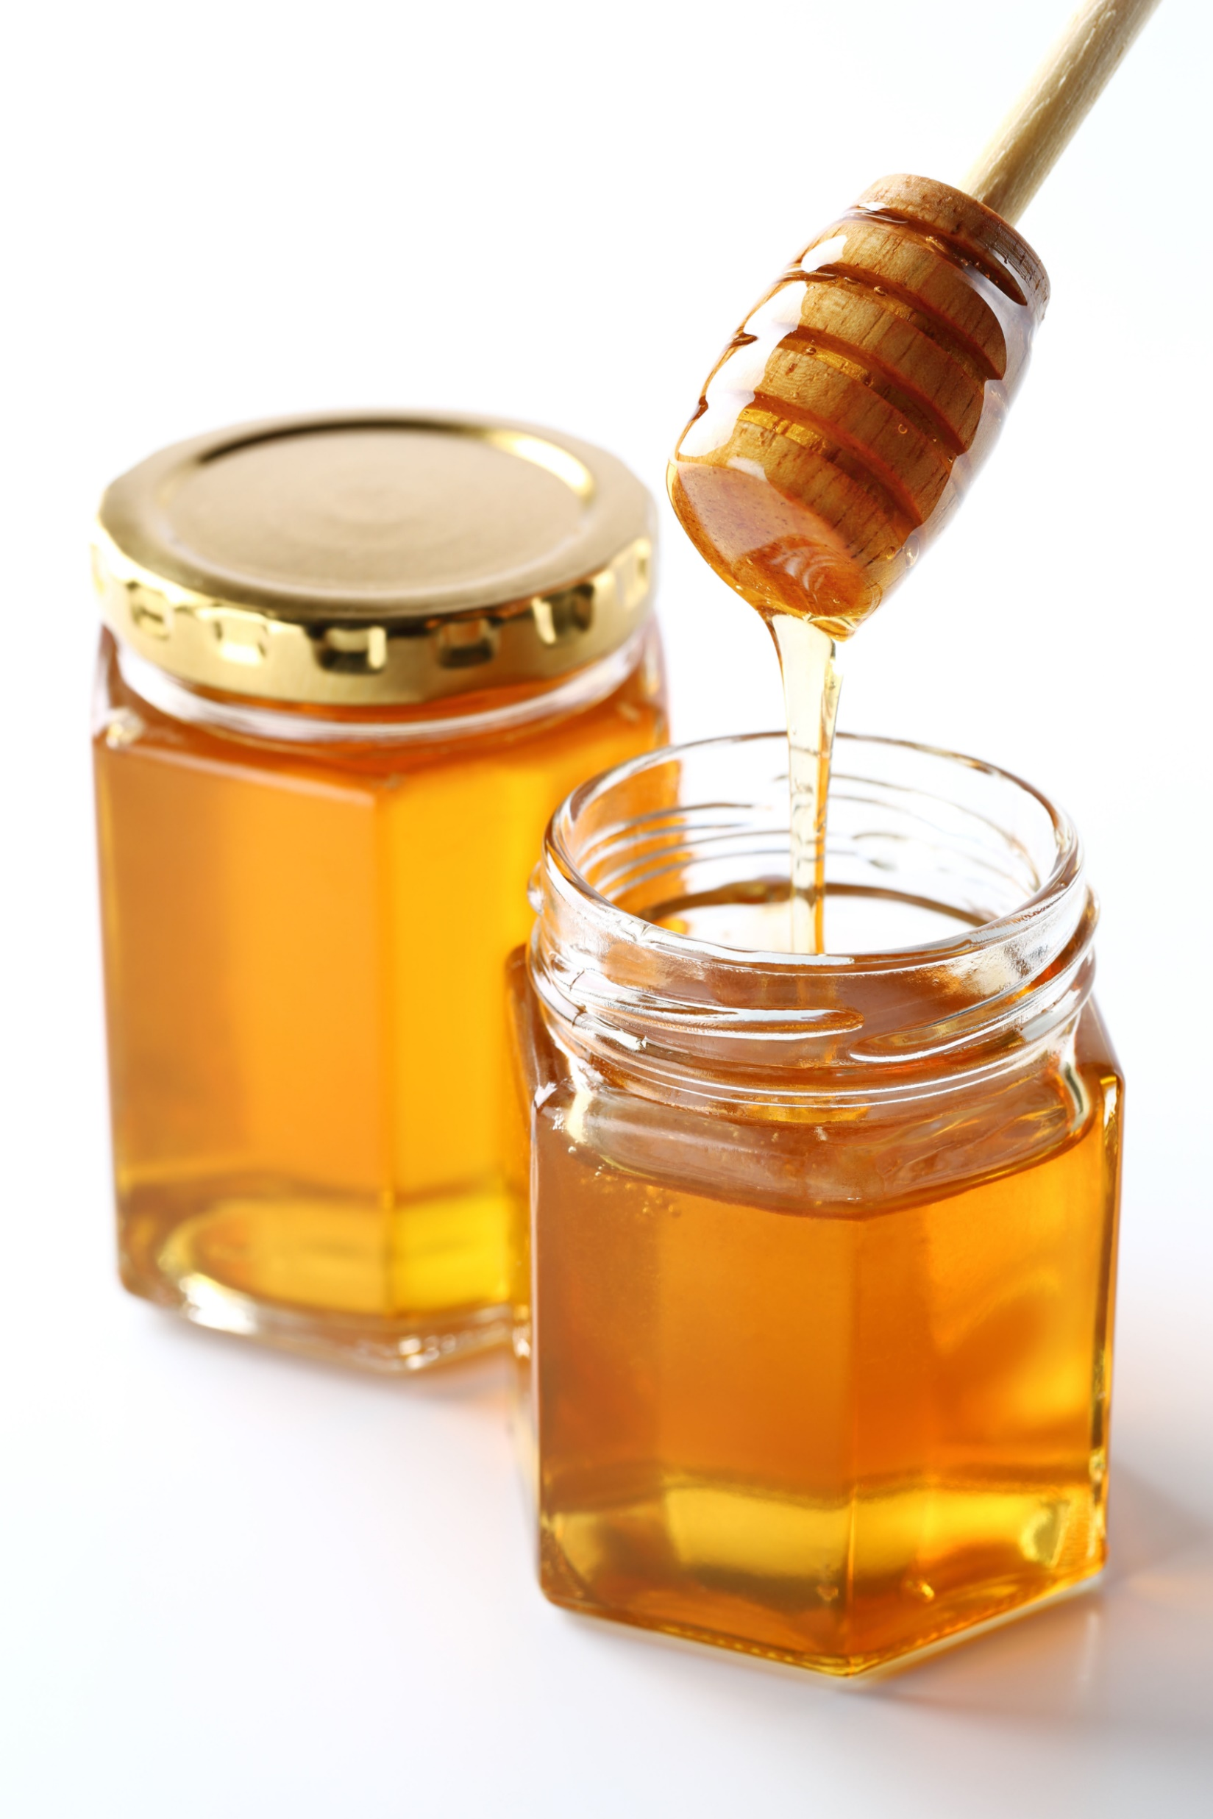
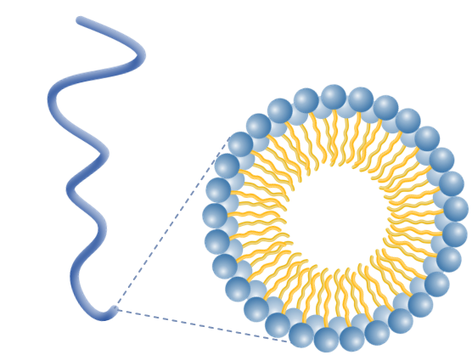
01
Initial
state
Viscosity
02
03
Worm-like
micelle
More
liquid-like
Shear-
thinning
Non-Newtonian Fluid
The viscosity changes upon applied
force (e.g. syrup, ketchup)
Shear rate
04
Worm-like
micelle
Decreased
Viscosity
The viscosity has a linear response
to the shear rate (e.g. water)

Slide 5
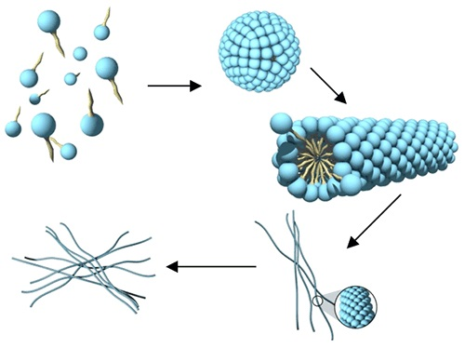
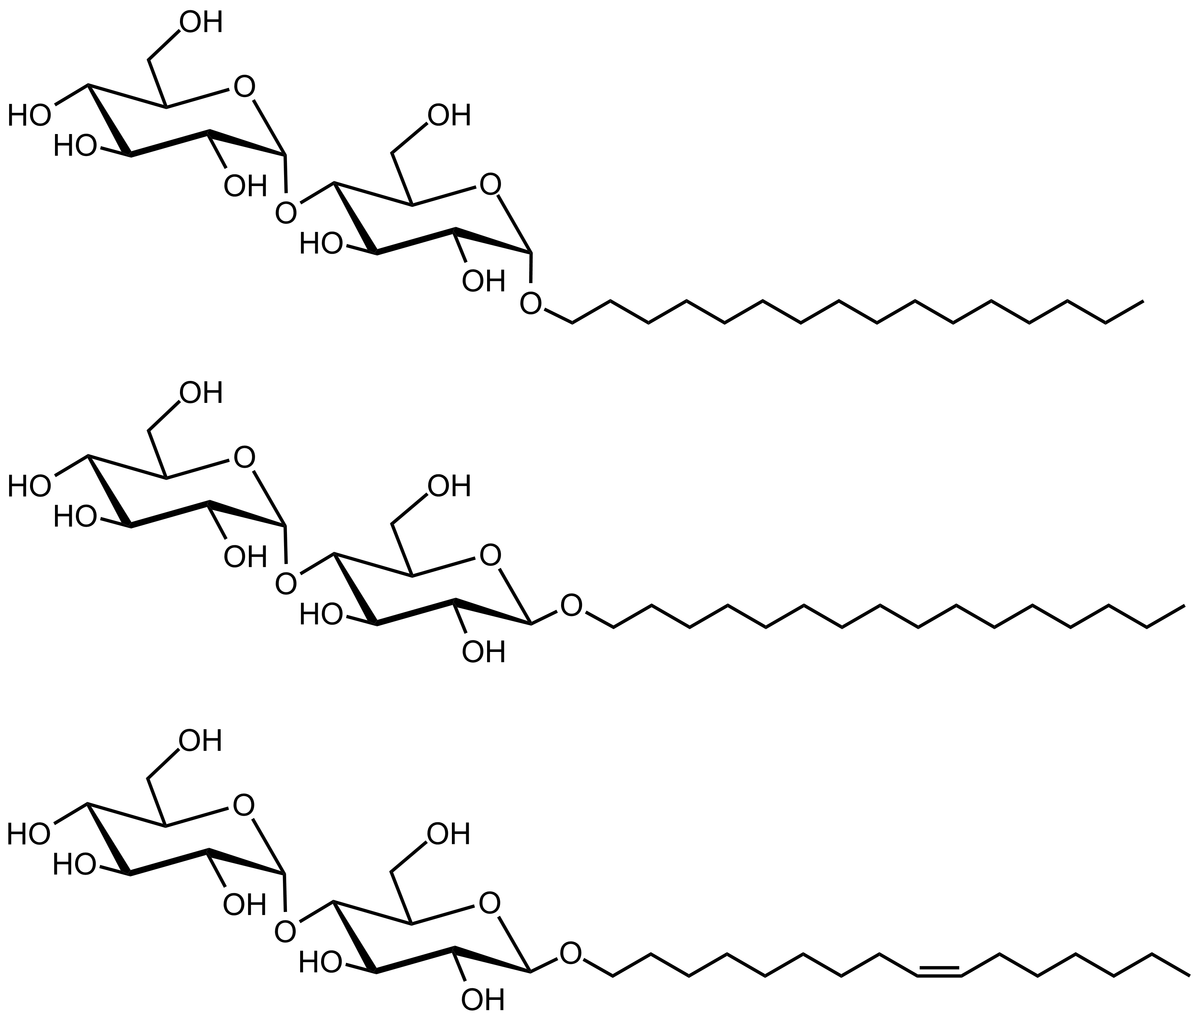
Background and Aims
Previous study:
Sugar-based Surfactants:
A Greener Option
=
01
Not dependent on fossil-based
raw materials
α-anomer
Sustainable
=
β-anomer
02
Stability
Biodegradable
SANS:
03
Minimized impact on aquatic
Environment
Ecosystem
04
Rheology
Non-Newtonian rheology

Slide 6
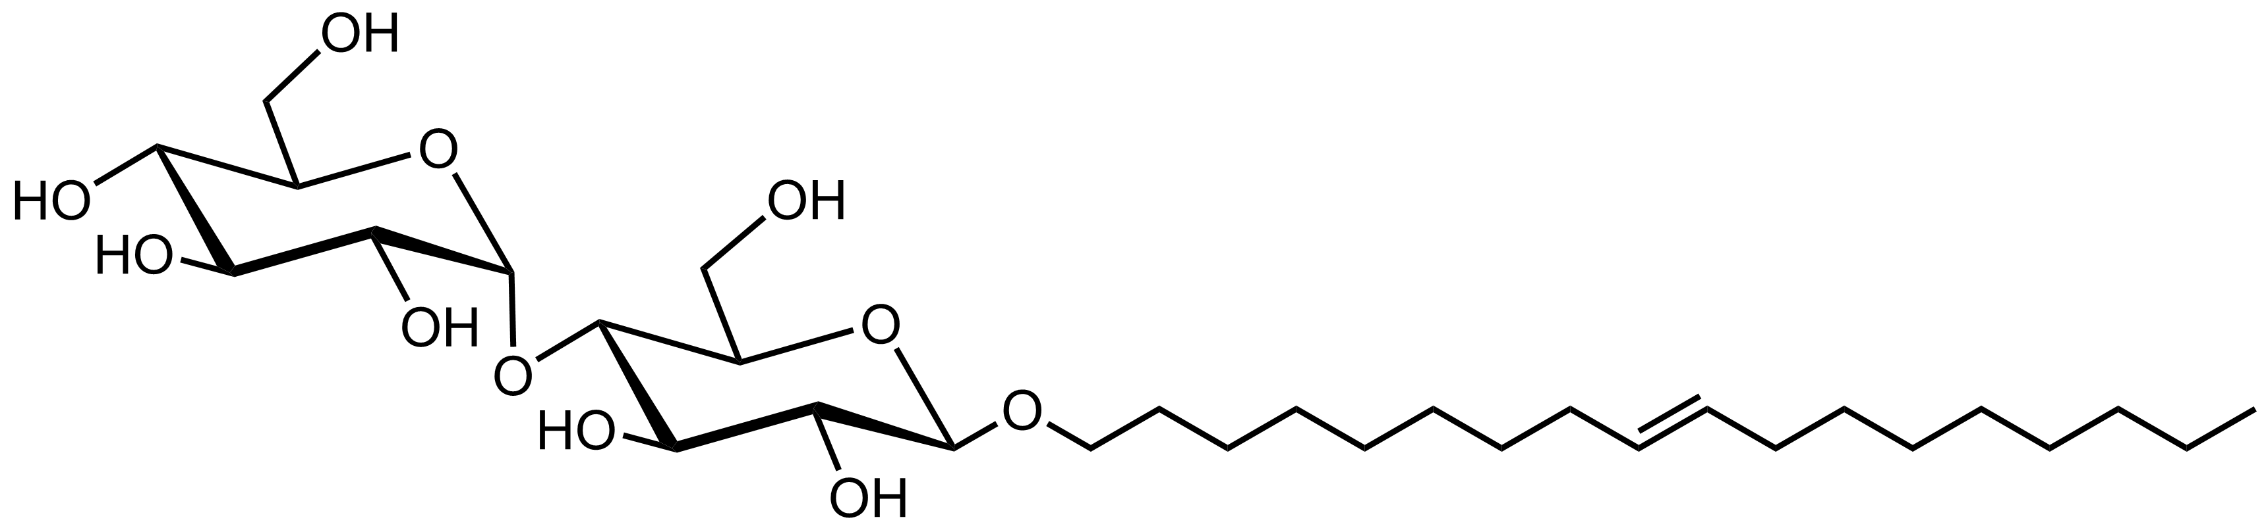
Background and Aims
Previous study:
Sugar-based Surfactants:
A Greener Option
=
01
Not dependent on fossil-based
raw materials
α-anomer
Sustainable
=
β-anomer
02
Stability
Biodegradable
This study:
=
03
Minimized impact on aquatic
Environment
Ecosystem
05
Objective
04
To fine-tune the rheology
with unsaturation
Rheology
Non-Newtonian rheology

Slide 7
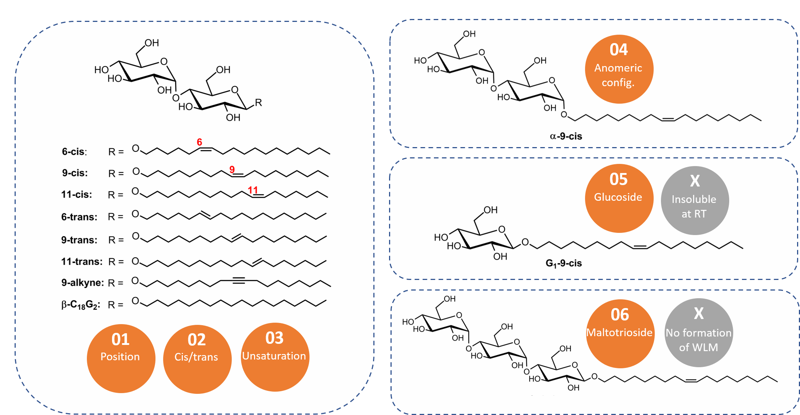

Library of sugar-based surfactants
To link the physical properties
with the chemical architecture
01
Synthesis of sugar-based
surfactants
Synthesis
02
Properties
Self-assembly
03
Rheology
Properties
G₃-9-cis

Slide 8
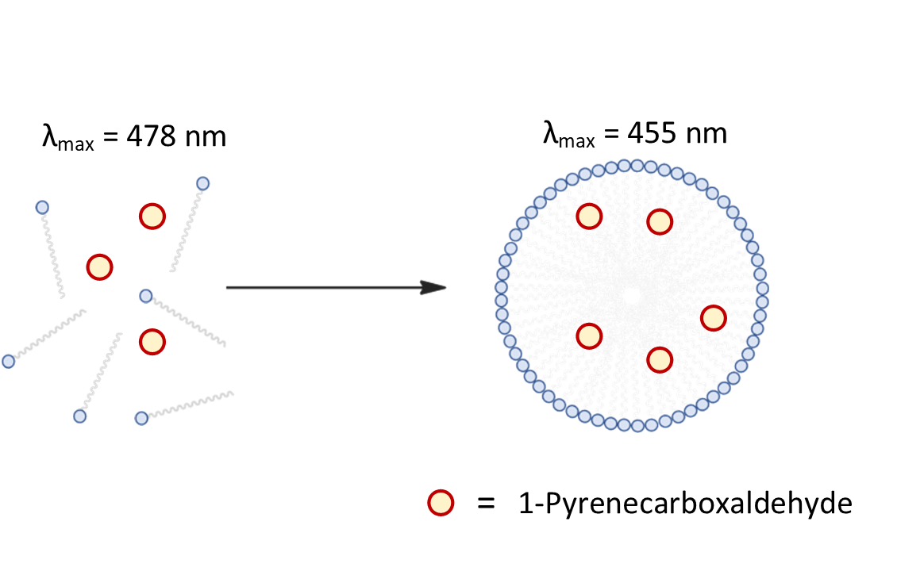
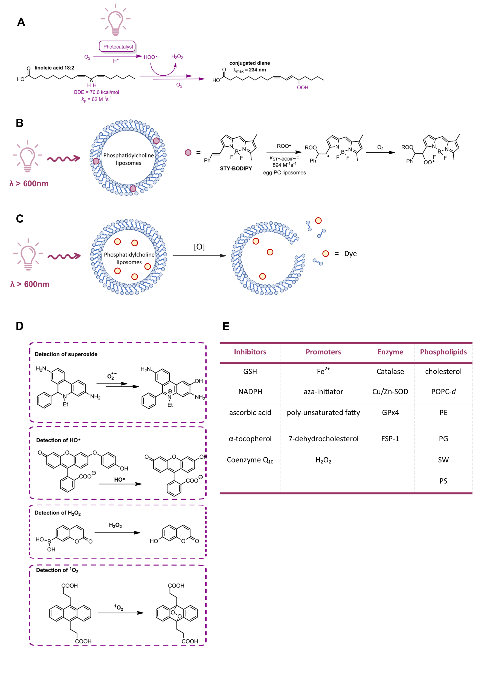
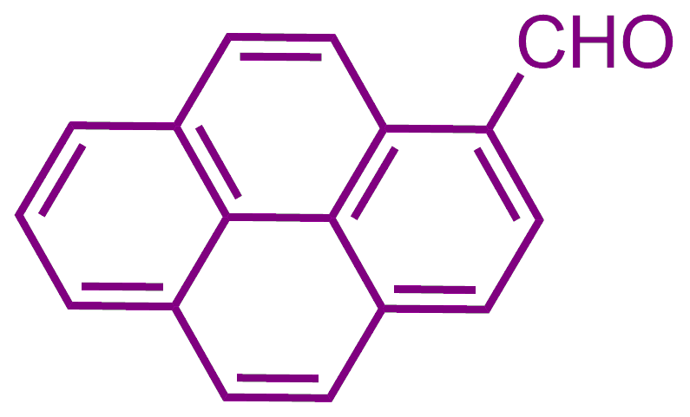
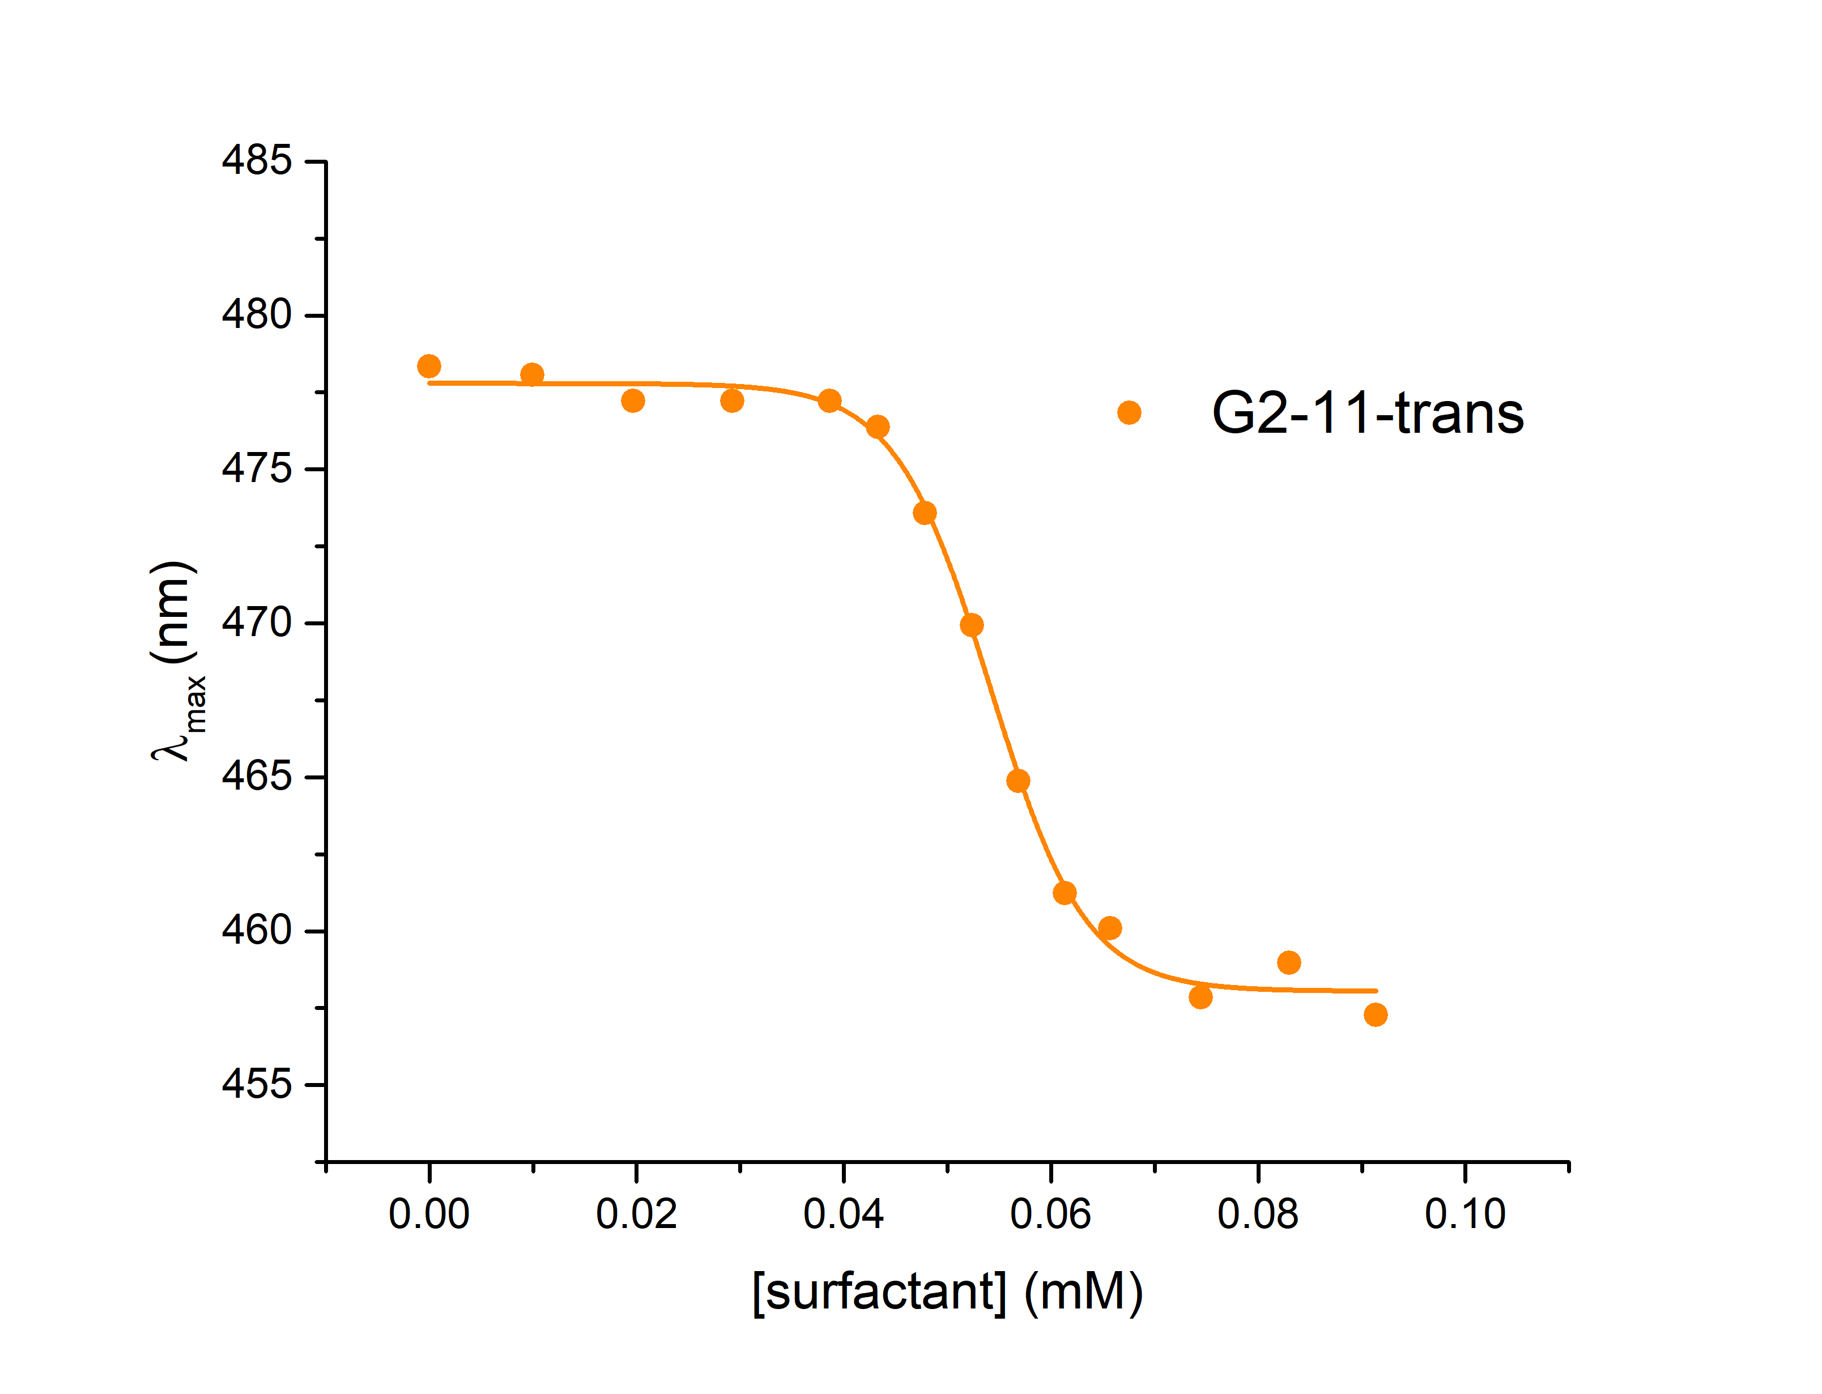
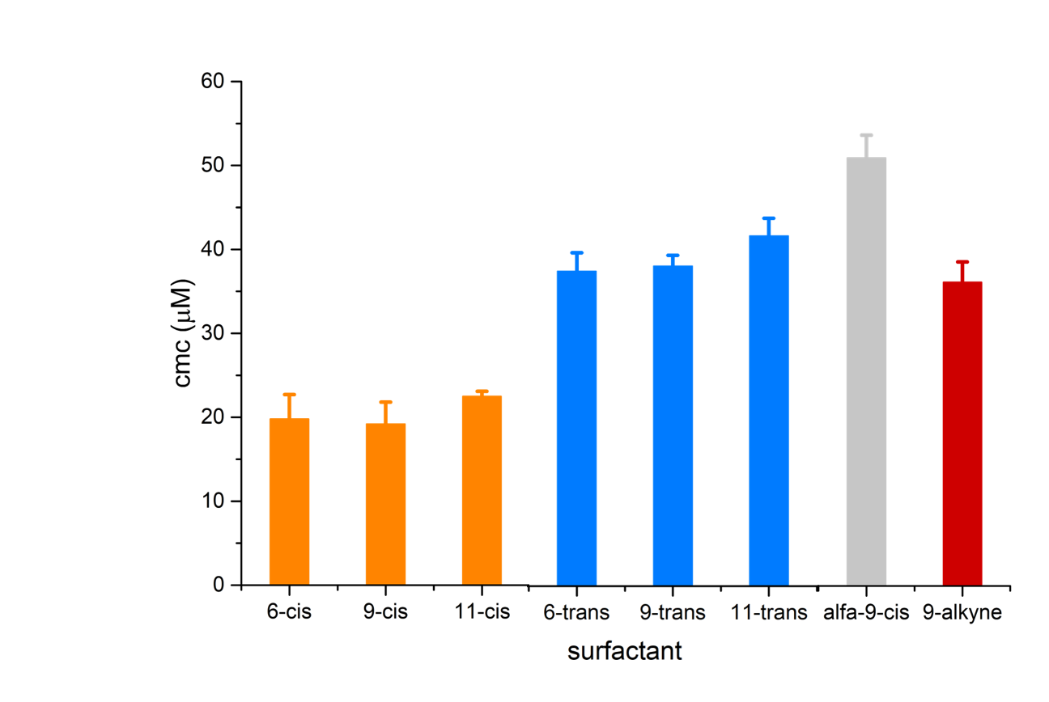
Self-assembly
To link the physical properties
with the chemical architecture
Surfactant
01
Synthesis of sugar-based
surfactants
Synthesis
02
Critical
micelle
conc.
Properties
Self-assembly
03
Rheology
Properties

Slide 9
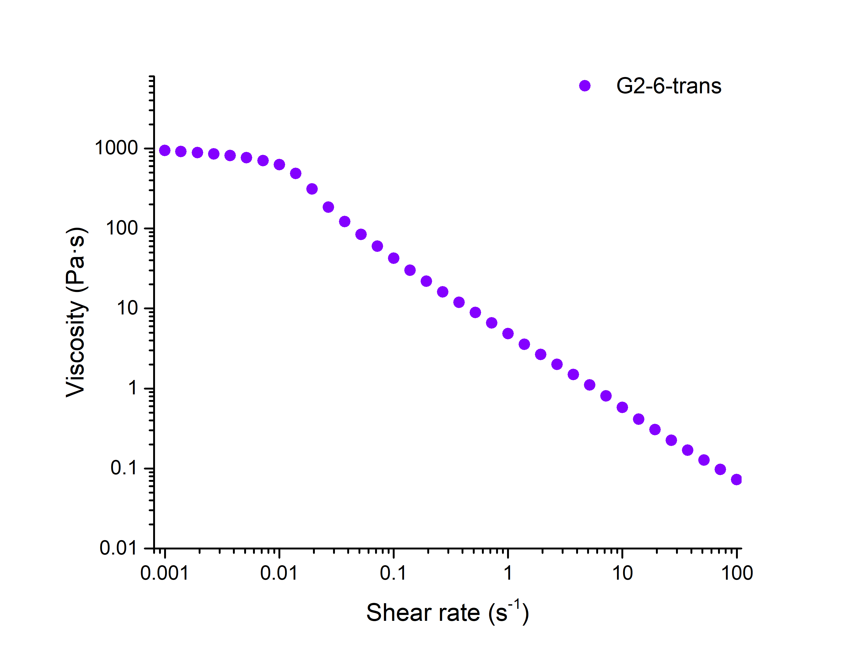
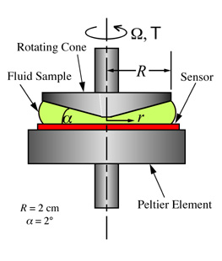

Linear rheology
To probe the Non-Newtonian rheological behaviour of WLM
To link the physical properties
with the chemical architecture
Zero-shear
viscosity
01
Synthesis of sugar-based
surfactants
Synthesis
02
Properties
Self-assembly
Critical
Shear-rate
03
Rheology
Properties
Rotational
movement

Slide 10

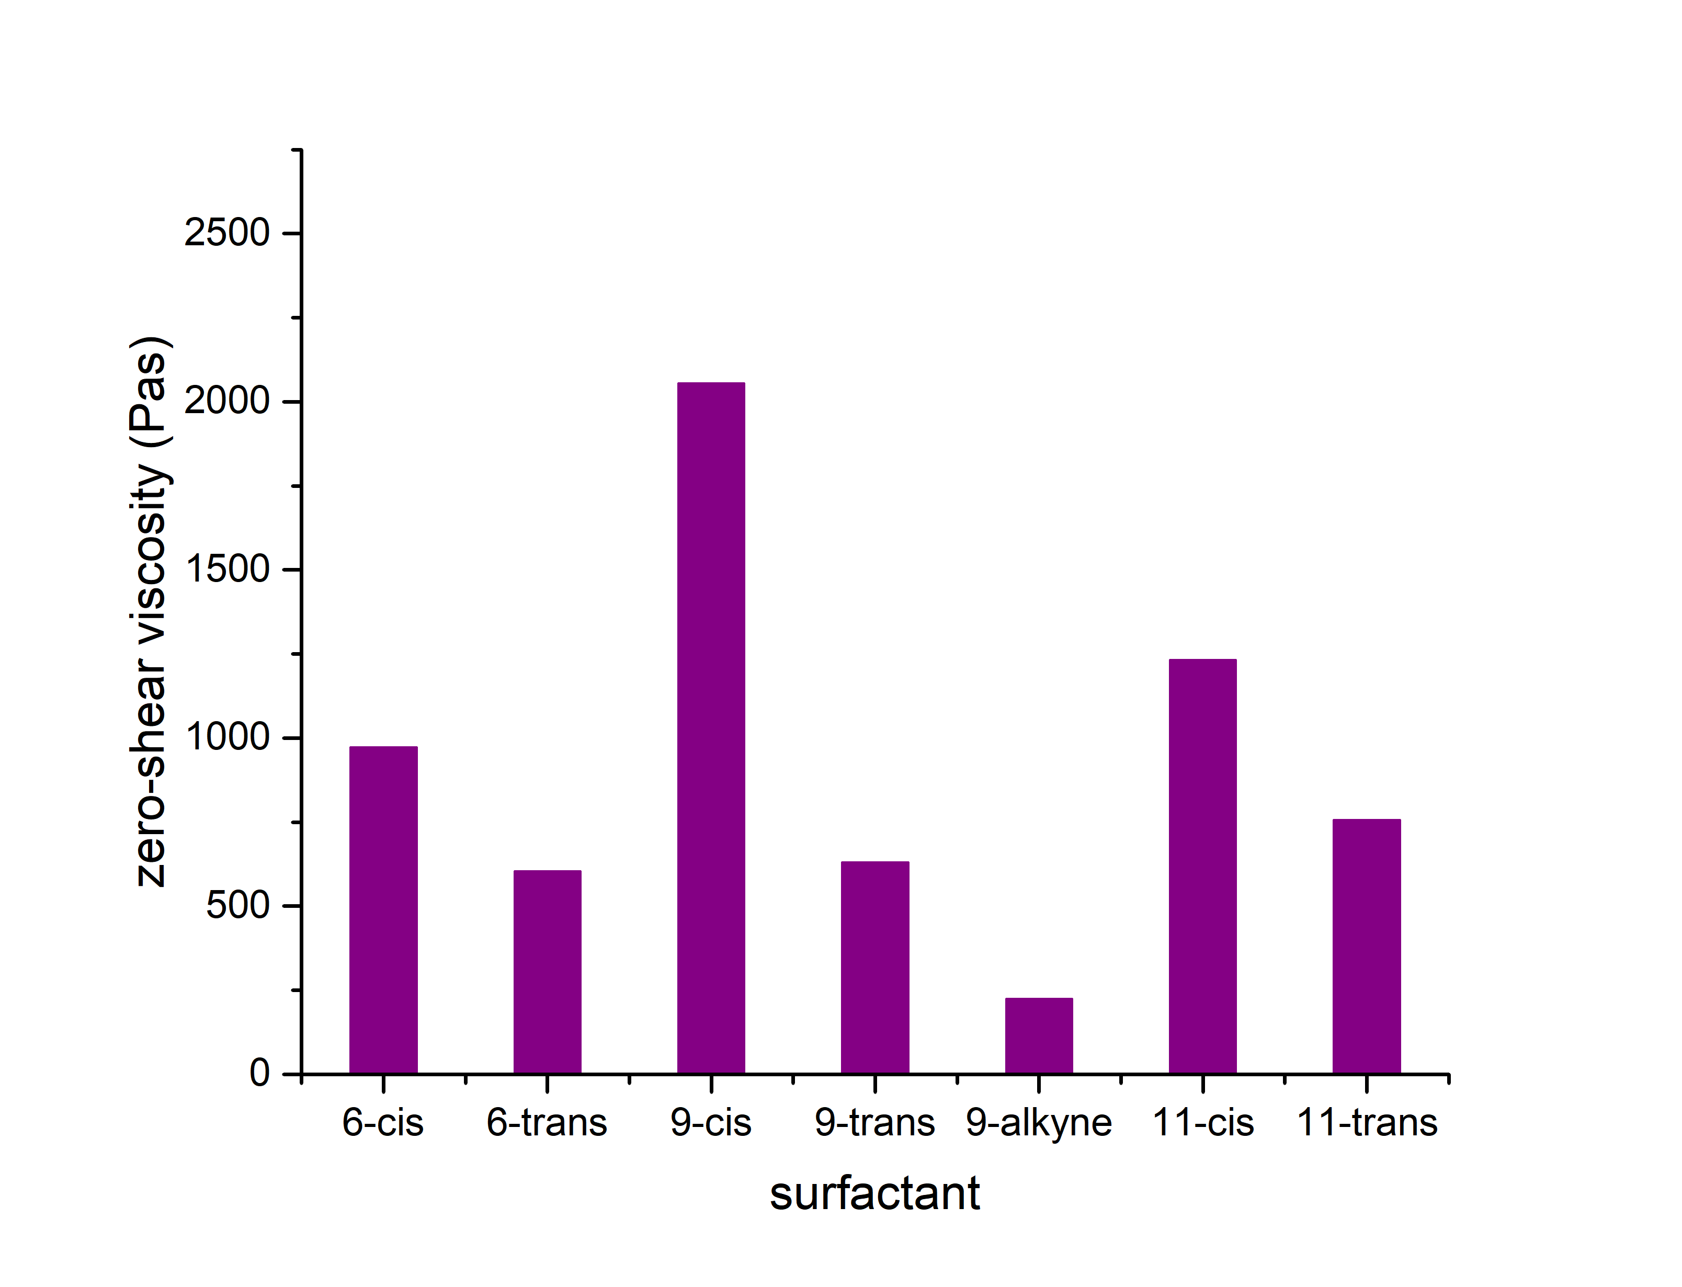
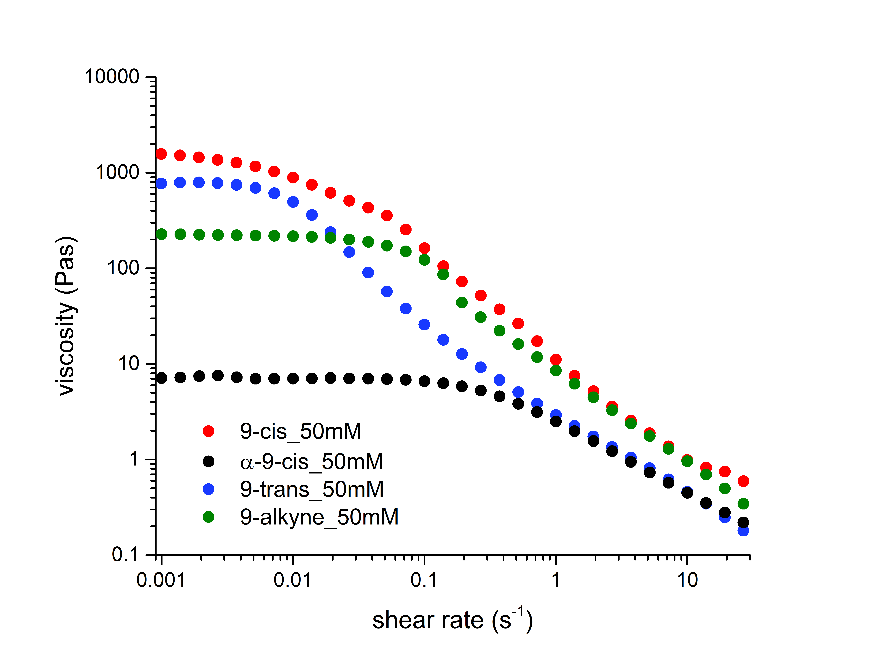
Linear rheology
To link the physical properties
with the chemical architecture
Influenced by
1) position
2) configuration of unsaturation
3) type of unsaturation
4) anomeric configuration
Shear-thinning
A broad range of zero-shear viscosity
01
Synthesis of sugar-based
surfactants
Synthesis
02
Properties
Self-assembly
03
Rheology
Properties

Slide 11
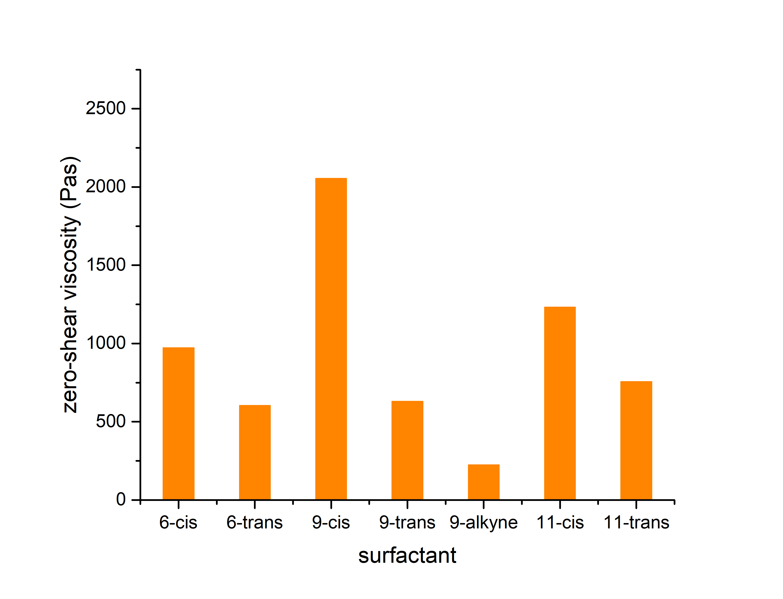
Linear rheology
To link the physical properties
with the chemical architecture
Influenced by
1) position
2) configuration of unsaturation
3) type of unsaturation
4) anomeric configuration
Shear-thinning
A broad range of zero-shear viscosity
01
Synthesis of sugar-based
surfactants
Synthesis
02
Properties
Self-assembly
03
Rheology
Properties

Slide 12
Linear rheology
To link the physical properties
with the chemical architecture
Influenced by
1) position
2) configuration of unsaturation
3) type of unsaturation
4) anomeric configuration
Shear-thinning
A broad range of zero-shear viscosity
01
Synthesis of sugar-based
surfactants
Synthesis
02
Properties
Self-assembly
03
Rheology
Properties

Slide 13
Linear rheology
To link the physical properties
with the chemical architecture
Influenced by
1) position
2) configuration of unsaturation
3) type of unsaturation
4) anomeric configuration
Shear-thinning
A broad range of zero-shear viscosity
01
Synthesis of sugar-based
surfactants
Synthesis
02
Properties
Self-assembly
03
Rheology
Properties

Slide 14
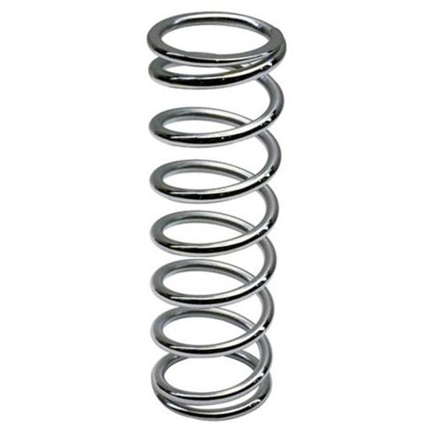
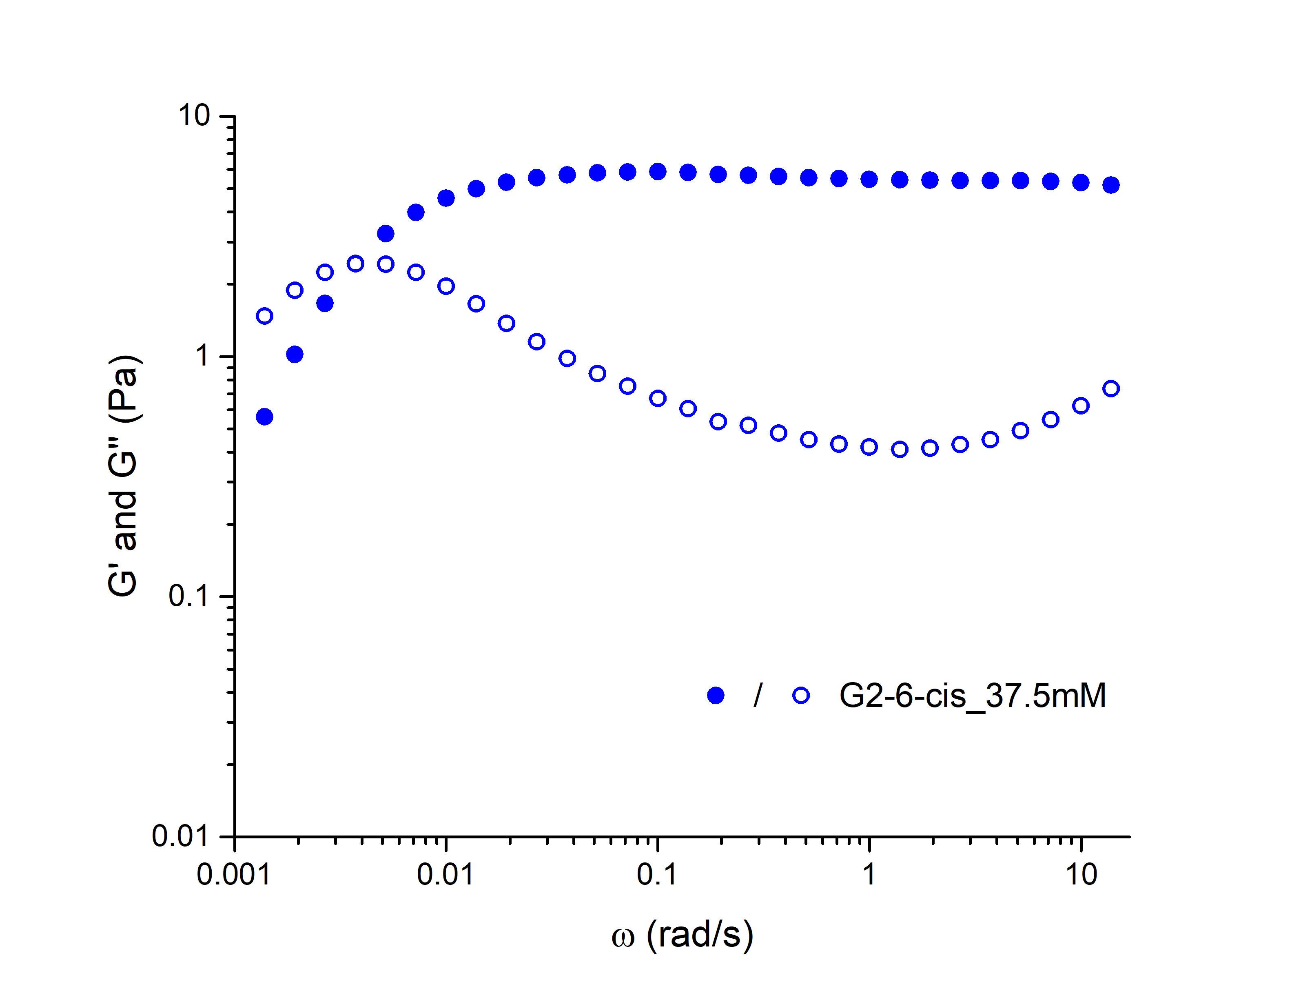

Oscillatory Rheology
Viscoelastic properties
Materials exhibit both viscous and elastic properties upon deformation
01
Intersection
= Relaxation time (τ)
01
G’ (●) = storage module; G” (○) = loss module
solid-like at high oscillation frequency
liquid-like at low oscillation frequency
Properties
G’
Elastic
02
The position of the unsaturation matters:
11-cis > 9-cis > 6-cis
G”
Regiochem.
Viscous
03
Stereochem.
Configuration of unsaturation: trans > cis
04
alkyne
Type of unsaturation: alkene > alkyne

Slide 15
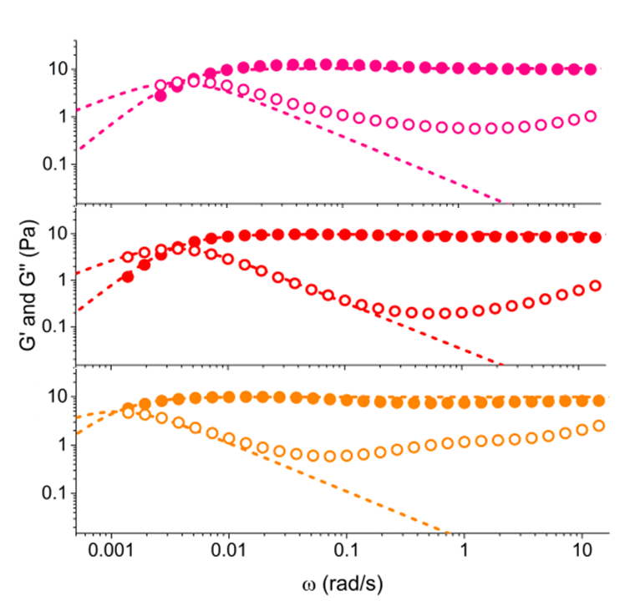
Oscillatory Rheology
Viscoelastic properties
Materials exhibit both viscous and elastic properties upon deformation
01
G’ (●) = storage module; G” (○) = loss module
solid-like at high oscillation frequency
liquid-like at low oscillation frequency
Properties
6-cis
τ = 268 s
02
The position of the unsaturation matters:
11-cis > 9-cis > 6-cis
Regiochem.
9-cis
τ = 294 s
03
Stereochem.
Configuration of unsaturation: trans > cis
11-cis
τ = 900 s
04
alkyne
Type of unsaturation: alkene > alkyne

Slide 16
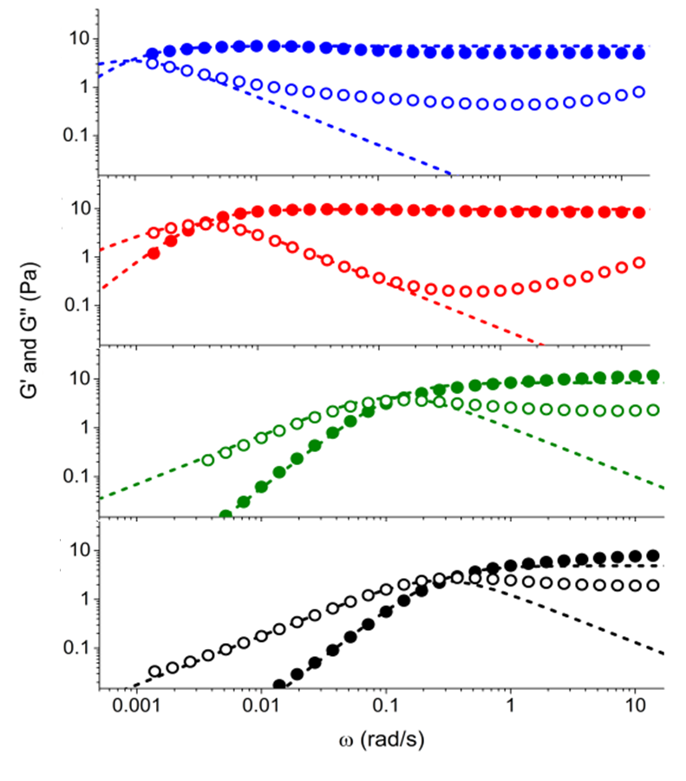
Oscillatory Rheology
Viscoelastic properties
Materials exhibit both viscous and elastic properties upon deformation
9-trans
τ = 1100 s
01
G’ (●) = storage module; G” (○) = loss module
solid-like at high oscillation frequency
liquid-like at low oscillation frequency
Properties
9-cis
τ = 294 s
02
The position of the unsaturation matters:
11-cis > 9-cis > 6-cis
Regiochem.
9-alkyne
τ = 8 s
03
Stereochem.
Configuration of unsaturation: trans > cis
α-9-cis
τ = 6 s
04
alkyne
Type of unsaturation: alkene > alkyne

Slide 17
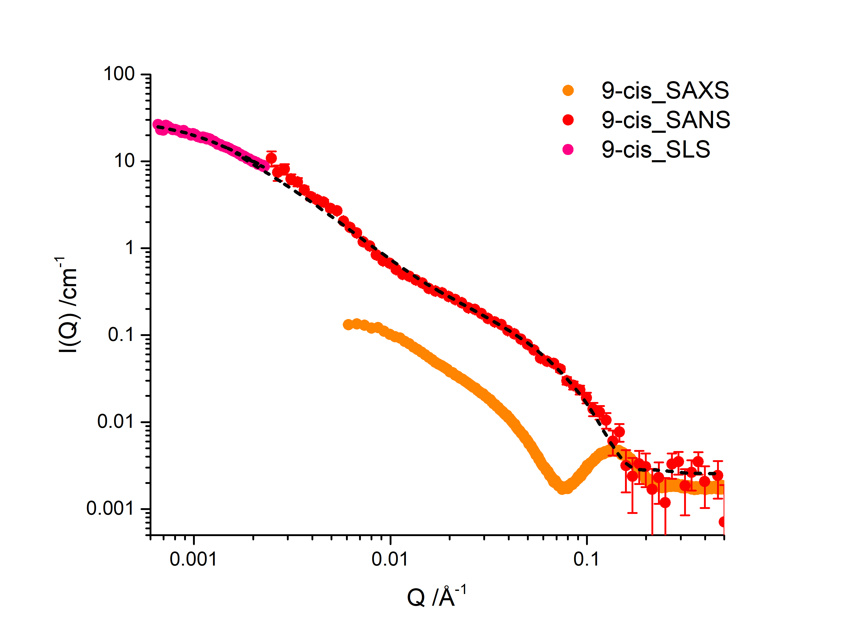
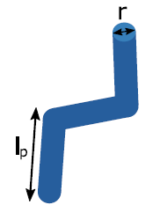
Structural Information
SANS, SAXS and SLS
The rheology profile is not associated to the diameter, but the contour
and persistence length of the WLM
Worm-like micelle
Cylindrical, elongated and entangled system
01
Contour
length
Persistence
length
Diameter
02
Persistence
length
03
L
Contour
length

Slide 18
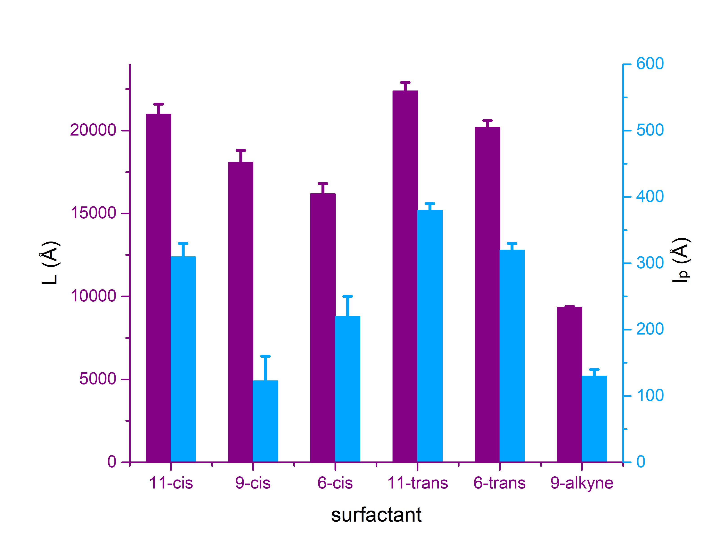
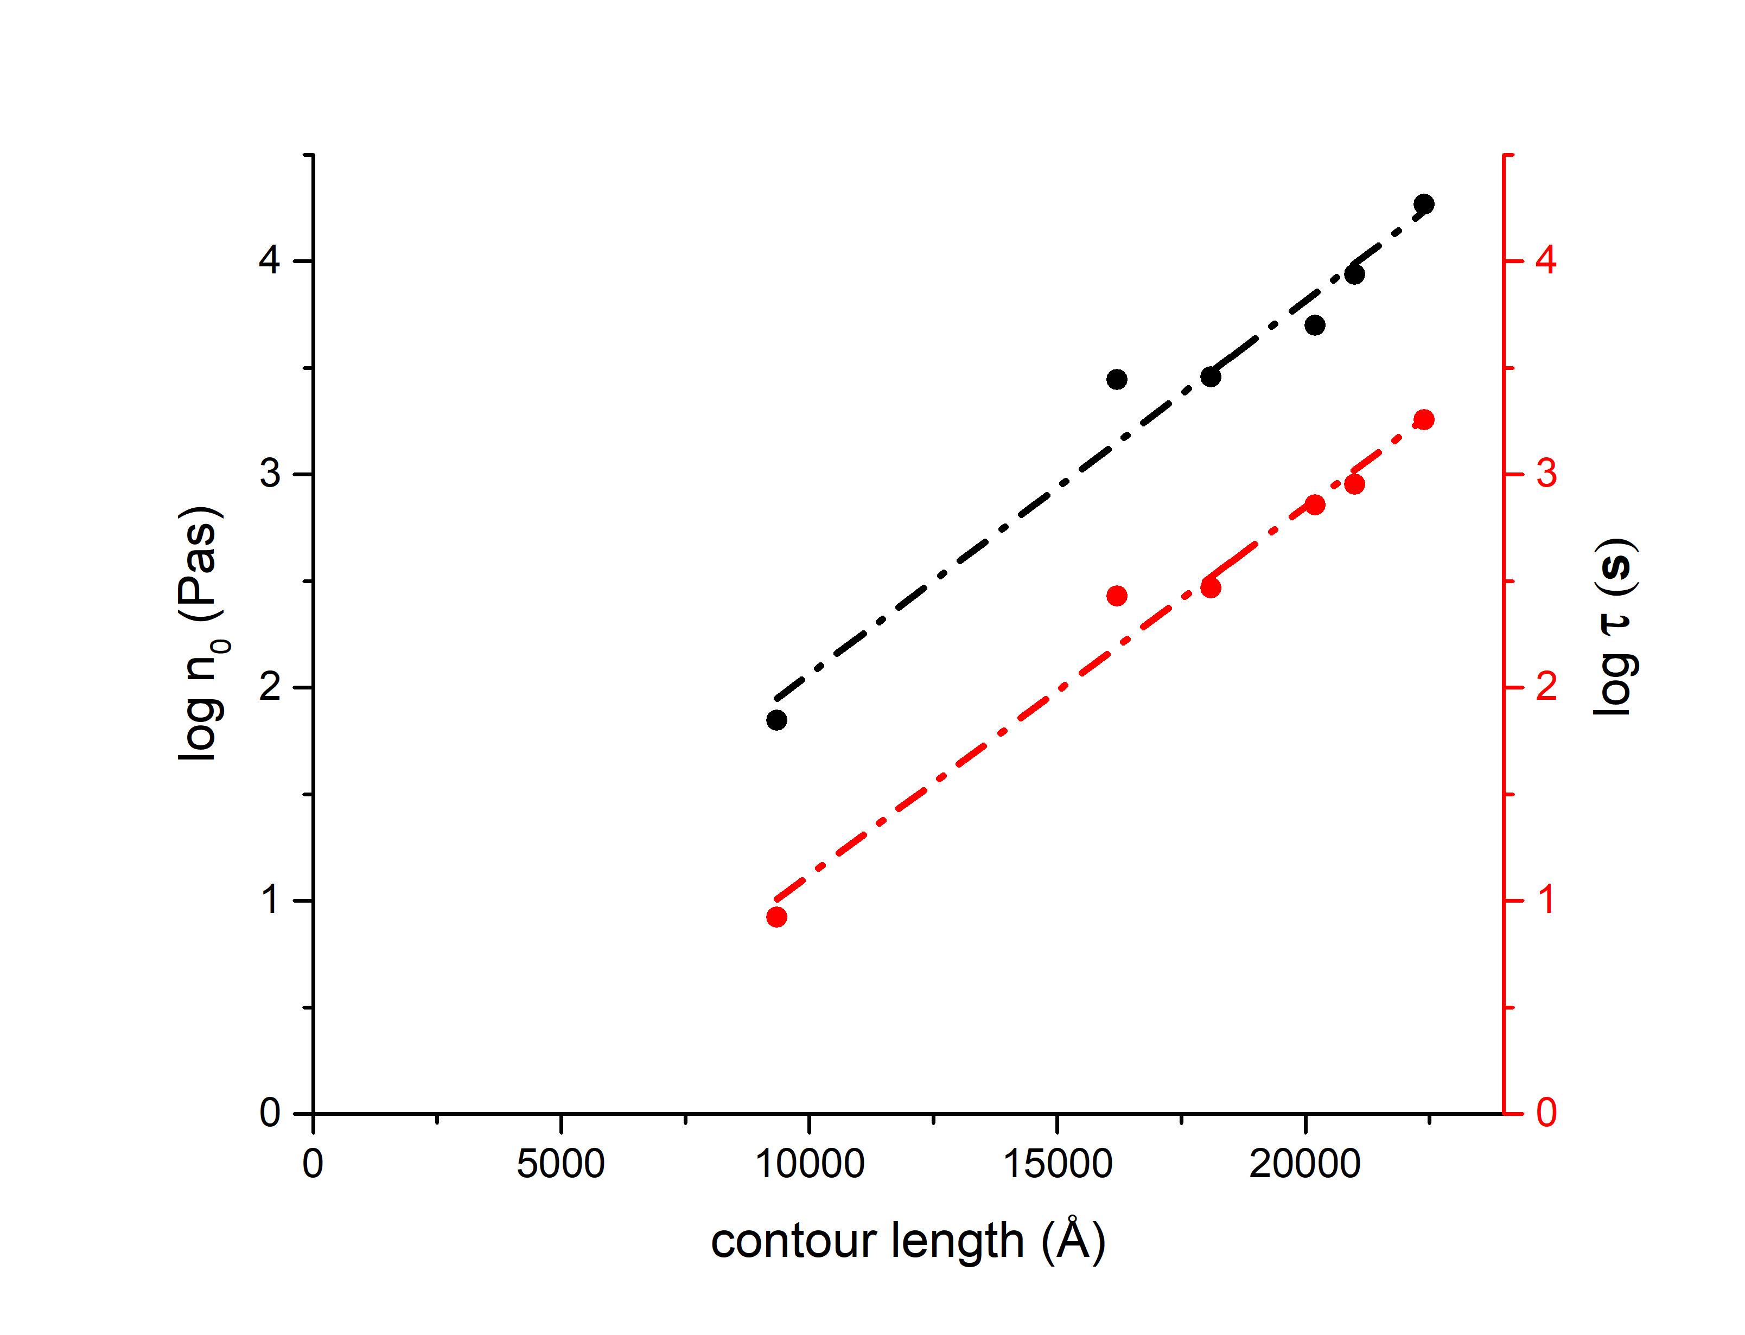
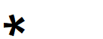
Structural Information
Effect of Unsaturation
Contour (L) and persistence length (l_{p}) are influenced by the configuration, position and types of unsaturation
Structure-Property Relationship
The longer the contour length, the more viscous the WLM
R² = 0.96
R² = 0.98

Slide 19



Self-assembly to
Worm-like Micelle
Structure-Property
Relationship
Sugar-based
Surfactants
Tail-
Unsaturation
Rheology

Slide 20


Marie Wahlgren
Adrian Sanchez-Fernandez
Najet Mahmoudi
Alessandro Gulotta
Stefan Ulvenlund

Slide 21
Thank YOU

